Slide 1

WALMART SALES Predictive Modeling
TS Project
By: Lani Lewis & Kenya Roy
December 8, 2024
Notes:
Welcome to the Walmart Sales Predictive Modeling Project Presentation brought to your by your hosts Lani Lewis and Kenya Roy. I’m Kenya and I’ll be kicking us off today with the EDA and passing it on to Lani.

Slide 2

W A L M A R T
EDA
W A L
Notes:
Walmart sales data provided by Kaggle; The original purpose of using the dataset online was to develop the best models to predict weekly sales in Walmart stores. Next we will talk about data preprocessing.

Slide 3

EDA | Data Preprocessing
TS Dataset Creation
Merge Data
Scale Data
Remove NA >50%
Split Data
Aggregate Date (Trend)
Notes:
These are the steps we took to process the data. It was important to scale our data because of the we are focusing on the weekly sales of Walmart stores with range from the hundred thousands to millions.

Slide 4
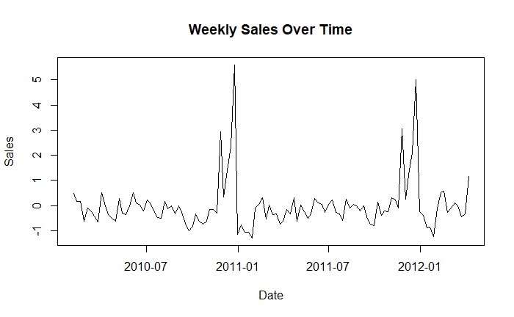

EDA | Understanding the Data
Holiday Peaks
November
December
Notes:
You can see the ts weekly observations ranging from 2010 to 2012 with holiday peaks in sales.

Slide 5
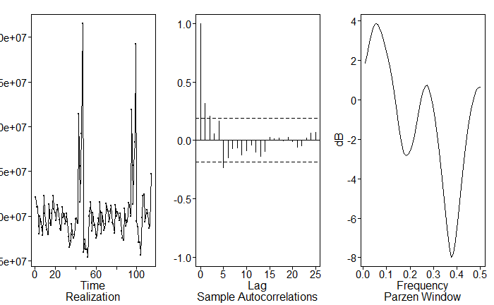

TSWGE PLOTS | Realization, ACF, Spectral Density
Notes:
- Realization: The sharp spikes and upward or downward trends suggest that the series is non-stationary (mean and variance are not constant over time).
- ACF: Strong correlations at lag 1 and lag 2, gradually decreasing, also indicating non-stationarity.
- Spectral Density: looks like we have three high peaks the first is the strongest and we see high peaks around period 12 (13/14)
- The next import periods are around 3 then 2...
- The overall behavior indicates that differencing might be required to stabilize the series. ---------------------------------------------------- How we found 1-B
Looking at the frequencies and spikes in the time series, we recognized a frequency of 52 and 12 in the TS
How we came up with 52 and 12 for spec dens

Slide 6

W A L M A R T
PROJECT MODELS
At least 2: ARMA / ARIMA / ARUMA / Signal Plus Noise
At least 1: VAR
At least 1: Neural Network (MLP)
At least 1: Ensemble model
W A L

Slide 7
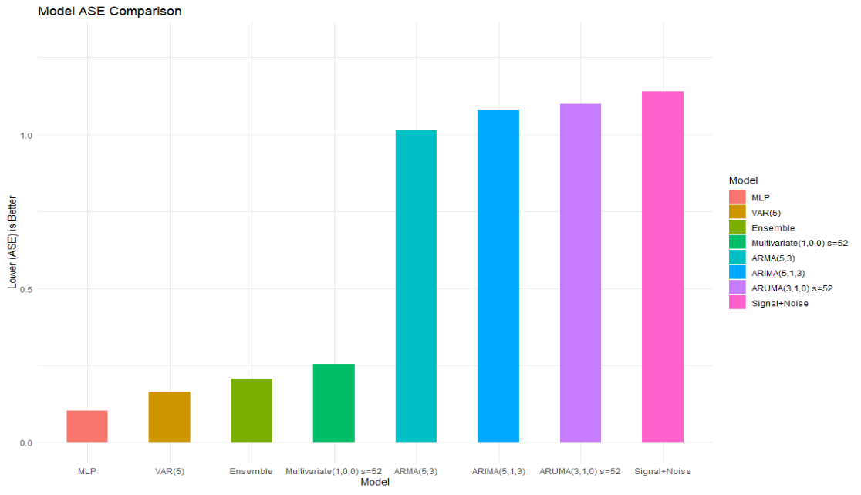

ASE MODEL REVIEW
Notes:
We also had the opportunity to use rolling window RMSE’s to compare some of the models we prepared for this project, however, we opted to use ASE’s only since the ASE metric can be applied universally.
As you can see, we prepared eight models overall but intend to present the 6 best performing models to you today. With that, I’ll pass it along to Lani who will dive into our best ARMA model.

Slide 8

W A L M A R T
ARMA(5,3) MODEL
W A L

Slide 9

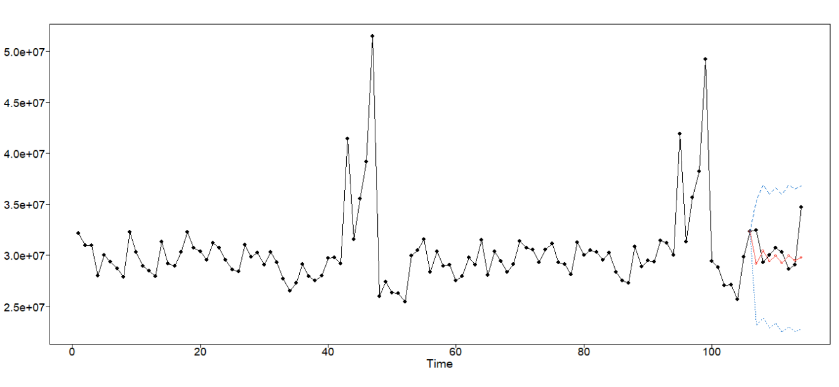
ARMA(5,3) MODEL FORECAST
ASE: 1.014748

Slide 10

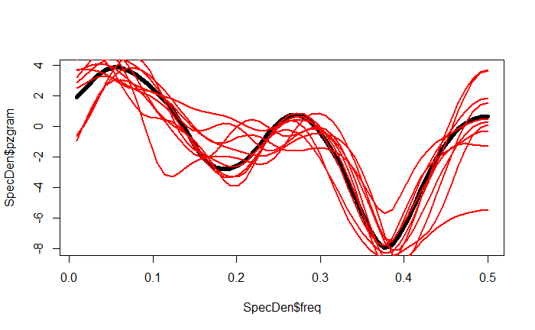
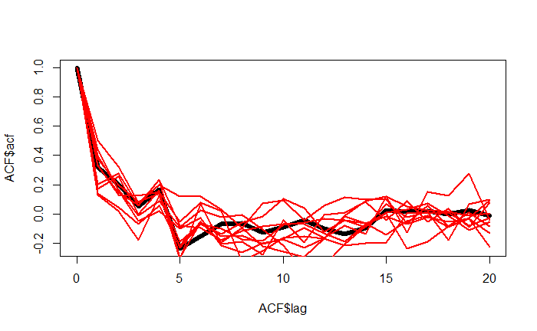
ARMA(5,3) MODEL COMPARISONS
10 Spectral Density Comparisons
10 ACF Comparisons

Slide 11

W A L M A R T
FINAL ARMA (5,3) MODEL
W A L

Slide 12

W A L M A R T
ARIMA(5,1,3) MODEL
W A L

Slide 13
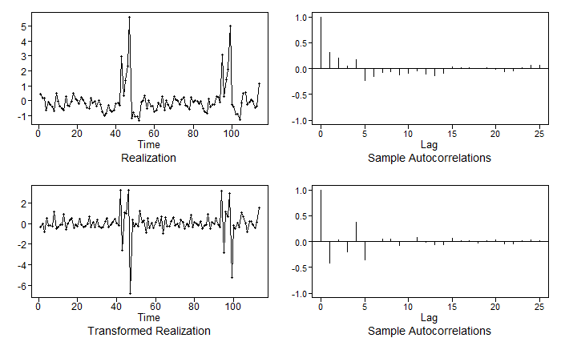

ARIMA(5,1,3) MODEL | Difference 1-B

Slide 14
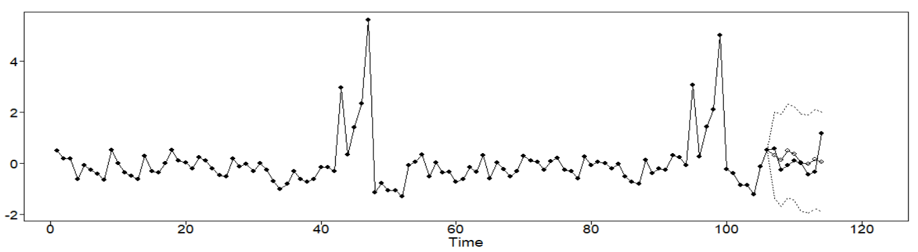

ARIMA(5,1,3) MODEL FORECAST
ASE: 1.077798

Slide 15

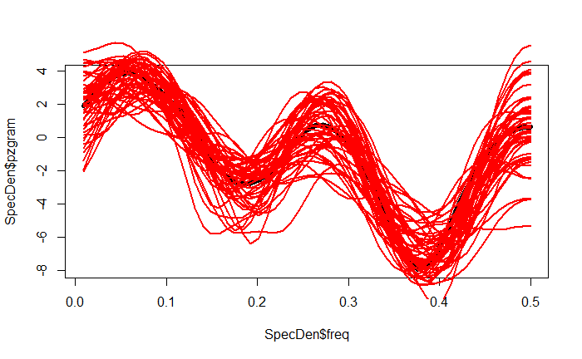
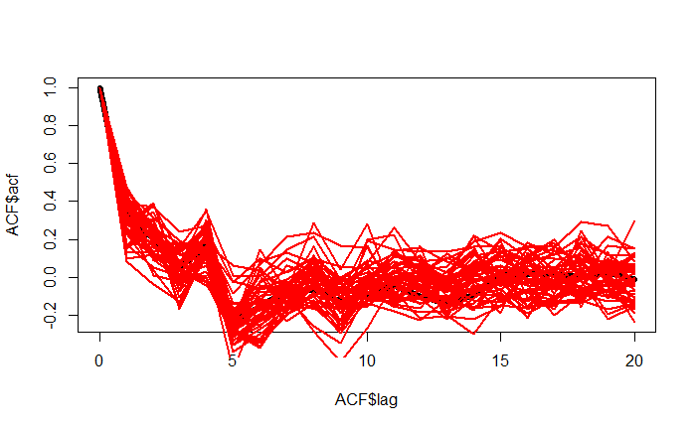
ARIMA(5,1,3) MODEL COMPARISONS
Spectral Density Comparisons
ACF Comparisons

Slide 16

W A L M A R T
FINAL ARIMA(5,1,3) MODEL
W A L

Slide 17

W A L M A R T
MULTIVARIATE ARUMA(1,0,0) w/ s=52 MODEL
W A L

Slide 18

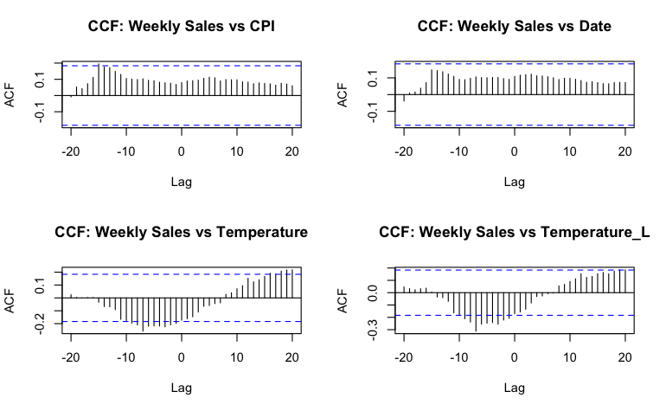
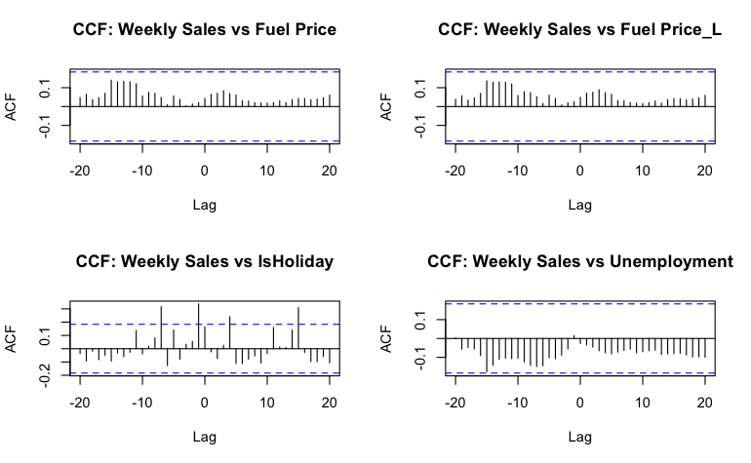
LAGGING VARIABLES
Notes:
We could have taken advantage of the different lags observed in these ACF plots but our content knowledge of the effect of Holidays on sales led us to decide to lag every variable by 1.

Slide 19

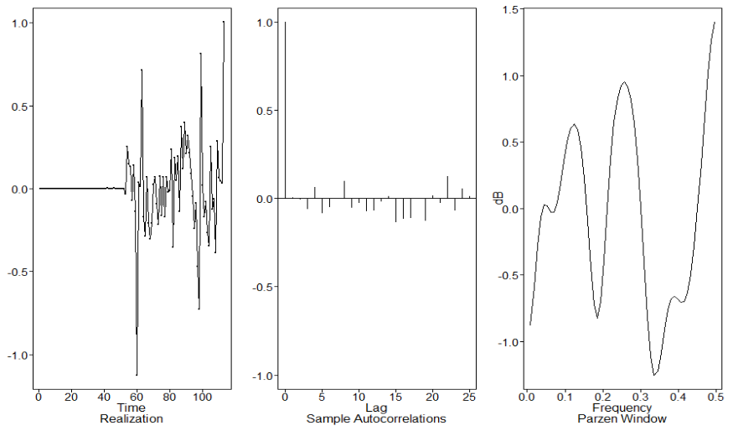
MULTIVARIATE MODEL |Fit ARUMA to residuals
Notes:
After fitting a regression model on scaled data, we stationarized the residuals using a seasonal difference of 52, and we ran AIC which recommended an order of 1,1,0 and returned an improved plots.

Slide 20
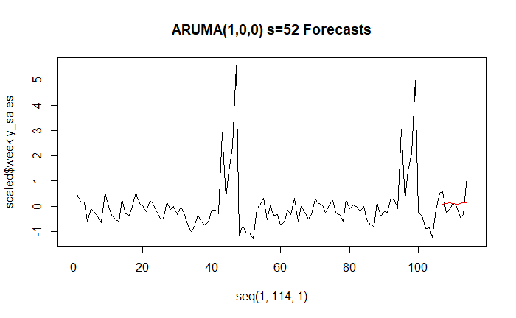

ARUMA(1,0,0) w/ S=52 MODEL FORECAST
ASE: 0.2549112
Notes:
We then moved on to forecasting. Despite the low ASE, the forecasts don’t line up which can be seen with the comparison of ACF and spectral densities.

Slide 21

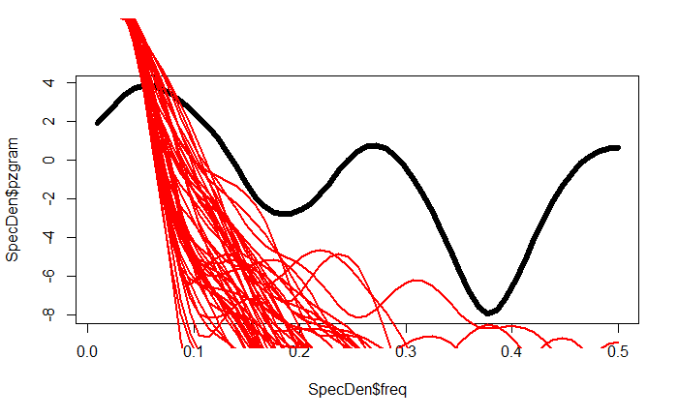
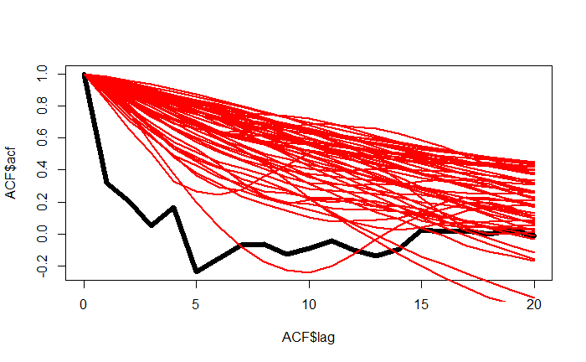
ARUMA(1,0,0) MODEL COMPARISONS
10 Spectral Density Comparisons
10 ACF Comparisons

Slide 22

W A L M A R T
FINAL MULTIVARIATE ARUMA(1,0,0) w/ s=52 MODEL
W A L

Slide 23

W A L M A R T
VAR(5) MODEL
W A L
Notes:
Scaled$weekly_sales data is stationarized

Slide 24
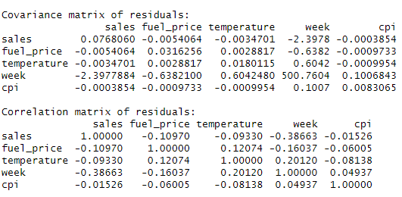

VAR(5) MODEL | Correlation and Covariance Matrices
VAR
Notes:
Using the stationary scaled data, we used Varselect which gave us a VAR(5) model using the scaled data. Covariance: Low residual variance for target variable (sales) shows that the model is good at predicting weekly sales
Correlation: sales and week’s residual shows that the model didn’t fully capture the trend in the TS in the correlation matrix

Slide 25
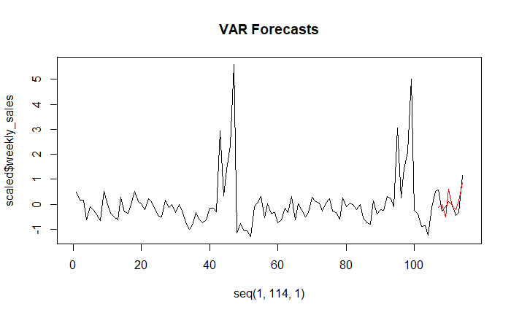

VAR(5) MODEL FORECAST
Average Lower CI: -0.4550076
Average Upper CI: 0.8153881
ASE: 0.16538
ASE: 1.757819e+12
Notes:
Fitting a model with seasonal dummy of 52, we calculated forecasts and found a pretty accurate model in VAR(5). We also found the upper and lower bounds of the confidence interval. Essentially, this model suggests that the scaled weekly sales at Walmart Stores is expected to fall between -0.4550 and .8154 with a 95% confidence.

Slide 26

W A L M A R T
FINAL VAR(5) MODEL
W A L
Notes:
Model equations for each variable here. Now I will pass this back to Lani to discuss the best performing MLP model

Slide 27

W A L M A R T
MLP MODEL
W A L

Slide 28

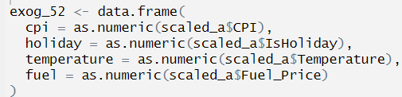
MLP MODEL | TS Configuration

Slide 29
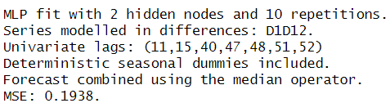
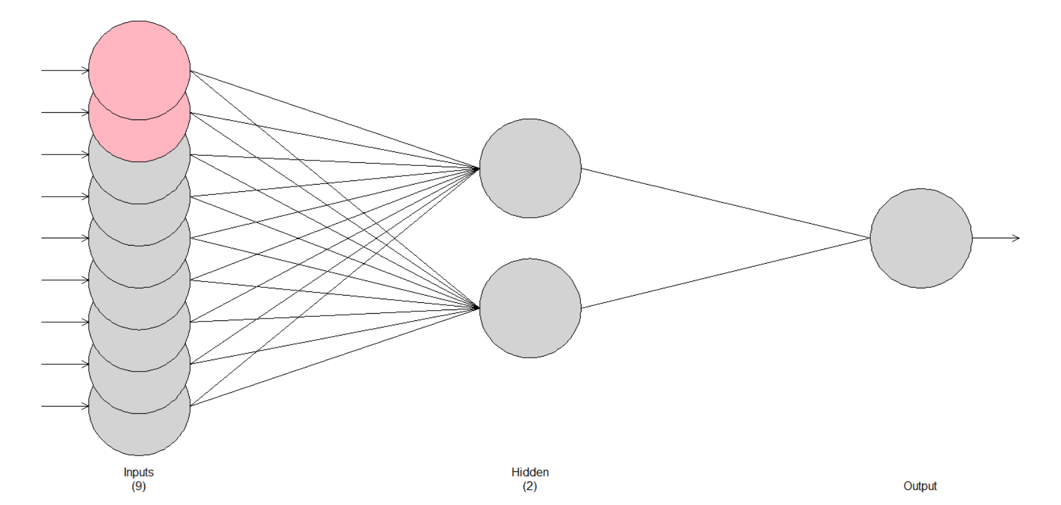

MLP MODEL
mlp52 = mlp(d52_train,reps = 10, comb = "median", difforder = c(1,12), allow.det.season = T, hd.auto.type = "cv", sel.lag = T, xreg = exog_52)

Slide 30

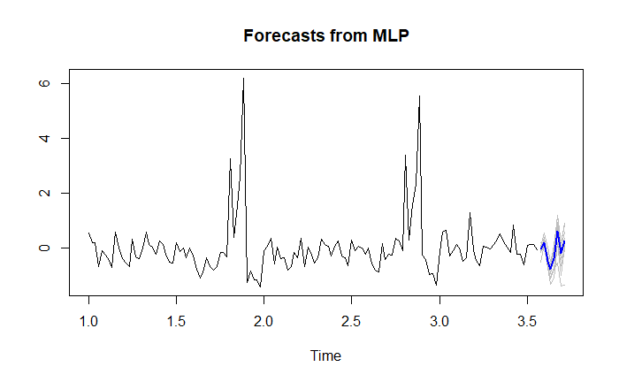
MLP MODEL FORECAST
ASE: 0.1026821

Slide 31

W A L M A R T
ENSEMBLE
W A L
Notes:
Thanks lani! Now to discuss the ensemble

Slide 32
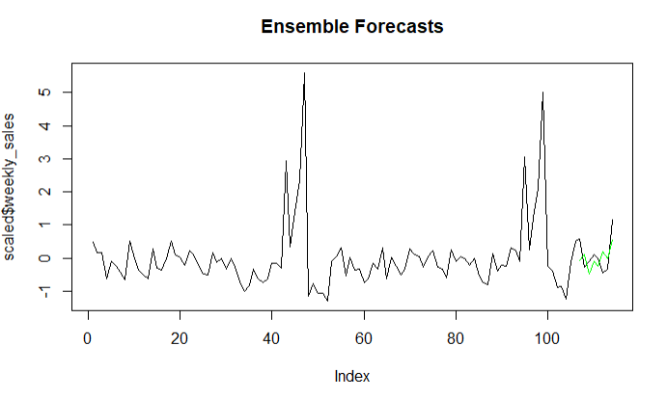

ENSEMBLE – MLP + VAR
ASE = 0.2080437
Notes:
Ensemble predictions were averages of the mean forecasts of MLP and VAR predictions.

Slide 33

W A L M A R T
Final Model Review
W A L
Notes:
1 minute tops

Slide 34
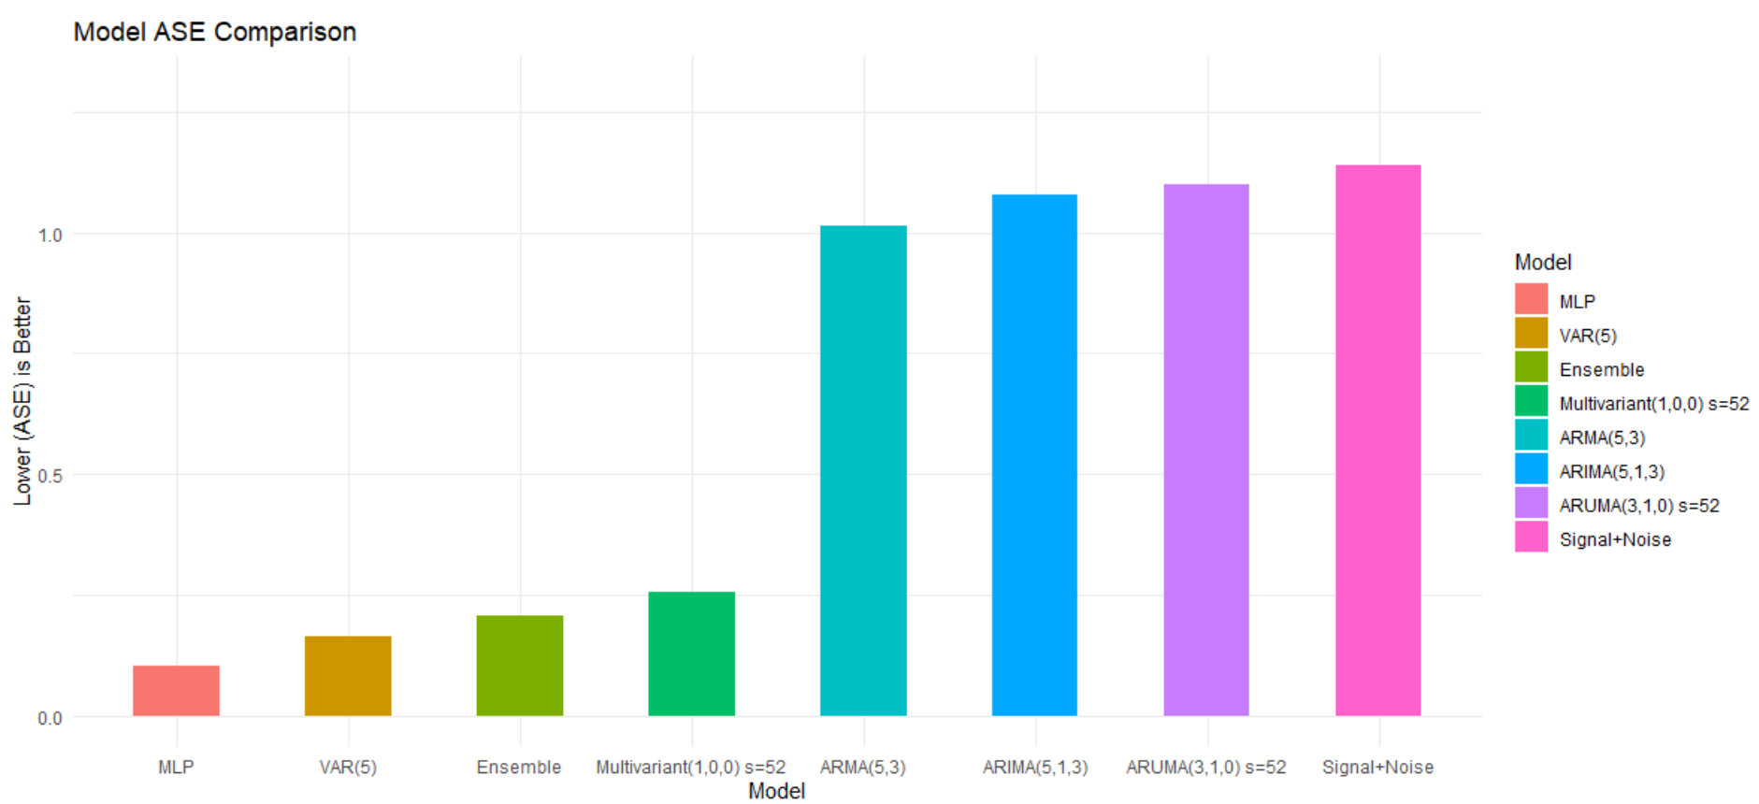

ASE MODEL REVIEW
Notes:
MLP 0.10268216
VAR(5) 0.16538168
Ensemble 0.20804375
Multivariate(1,0,0) s=52 0.25491121
ARMA(5,3)1.01474772
ARIMA(5,1,3)1.07779773
ARUMA(3,1,0) s=52 1.09979194
Signal+Noise1.1394492
MLP had the closest predictions to the actual observed values.

Slide 35
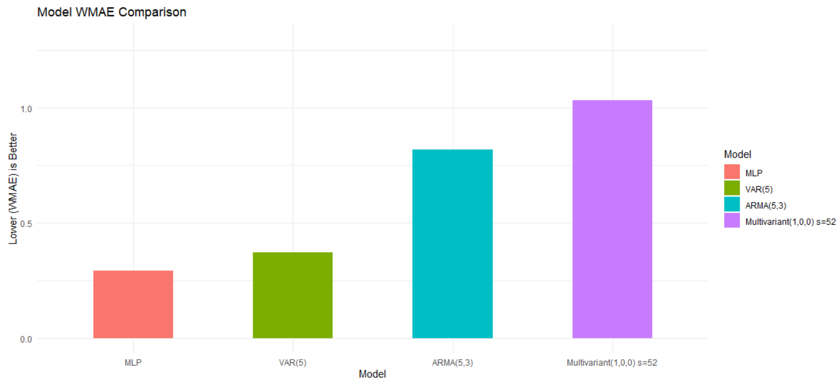

KAGGLE WMAE BEST MODELS REVIEW

Slide 36

W A L M A R T
Thank-You
For additional inquiries, please contact Lani Lewis (lanil@mail.smu.edu) and Kenya Roy (kroy@mail.smu.edu)
W A L
Notes:
While we recommend the use of the MLP model, we also would like to include the caveat that all models are wrong and some are useful. We encourage you to explore the many models we’ve developed and use the one that fits your needs. If you have additional inquiries please don’t hesitate to reach out to me and Lani. Thank you!

